Slide 1

Personalized Medicine: Redefining Cancer Treatment
Matt Shaffer · W207 Final Project · 16 August 2017

Slide 2



Workflow
Features
A molecular pathologist selects a list of genetic variations of interest that he/she want to analyze
The molecular pathologist searches for evidence in the medical literature that somehow are relevant to the genetic variations of interest
Finally, this molecular pathologist spends a huge amount of time analyzing the evidence related to each of the variations to classify them
Goal
Replace step 3 by a machine learning model.
1. Gene
(the gene where this genetic mutation is located)
2. Variation
(the aminoacid change for this mutation)
3. Class
(1-9 the class this genetic mutation has been classified on)
4. Text corpus
(the clinical evidence used to classify the genetic mutation)

Slide 3
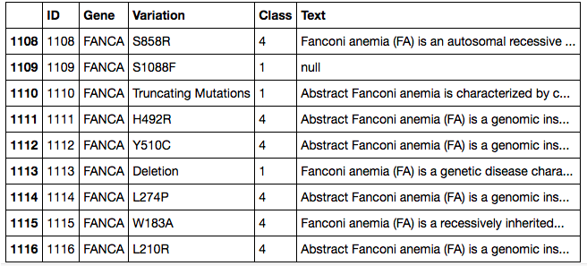
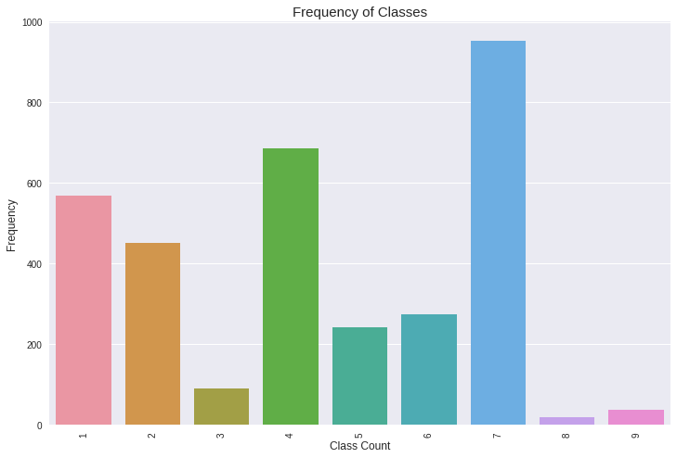
CLASSES
1. Likely Loss-of-function
2. Likely Gain-of-function
3. Neutral
4. Loss-of-function
5. Likely Neutral
6. Inconclusive
7. Gain-of-function
8. Likely Switch-of-function
9. Switch-of-function
https://www.kaggle.com/sudalairajkumar/simple-exploration-notebook-personalized-medicine

Slide 4
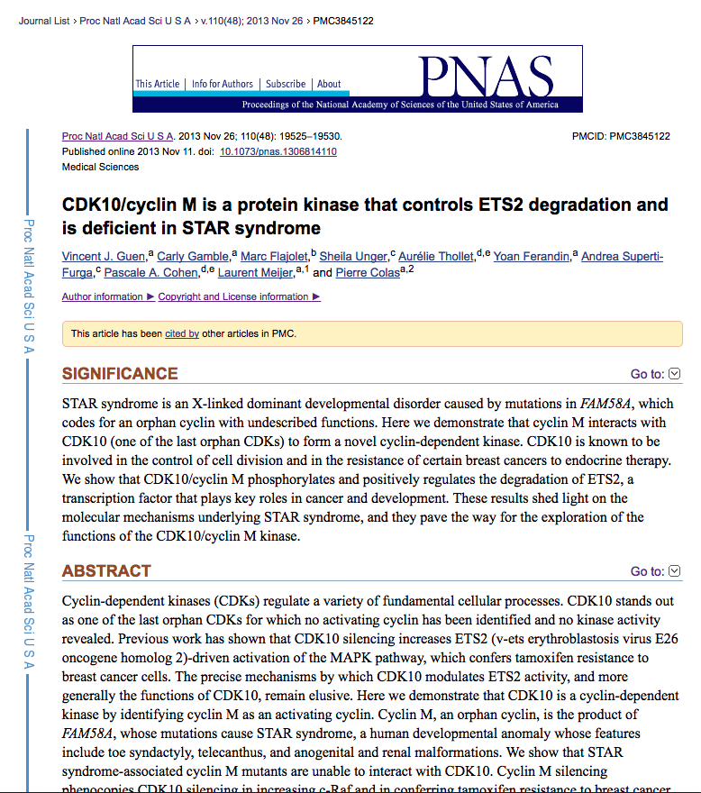

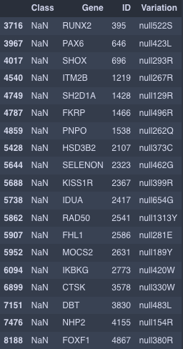
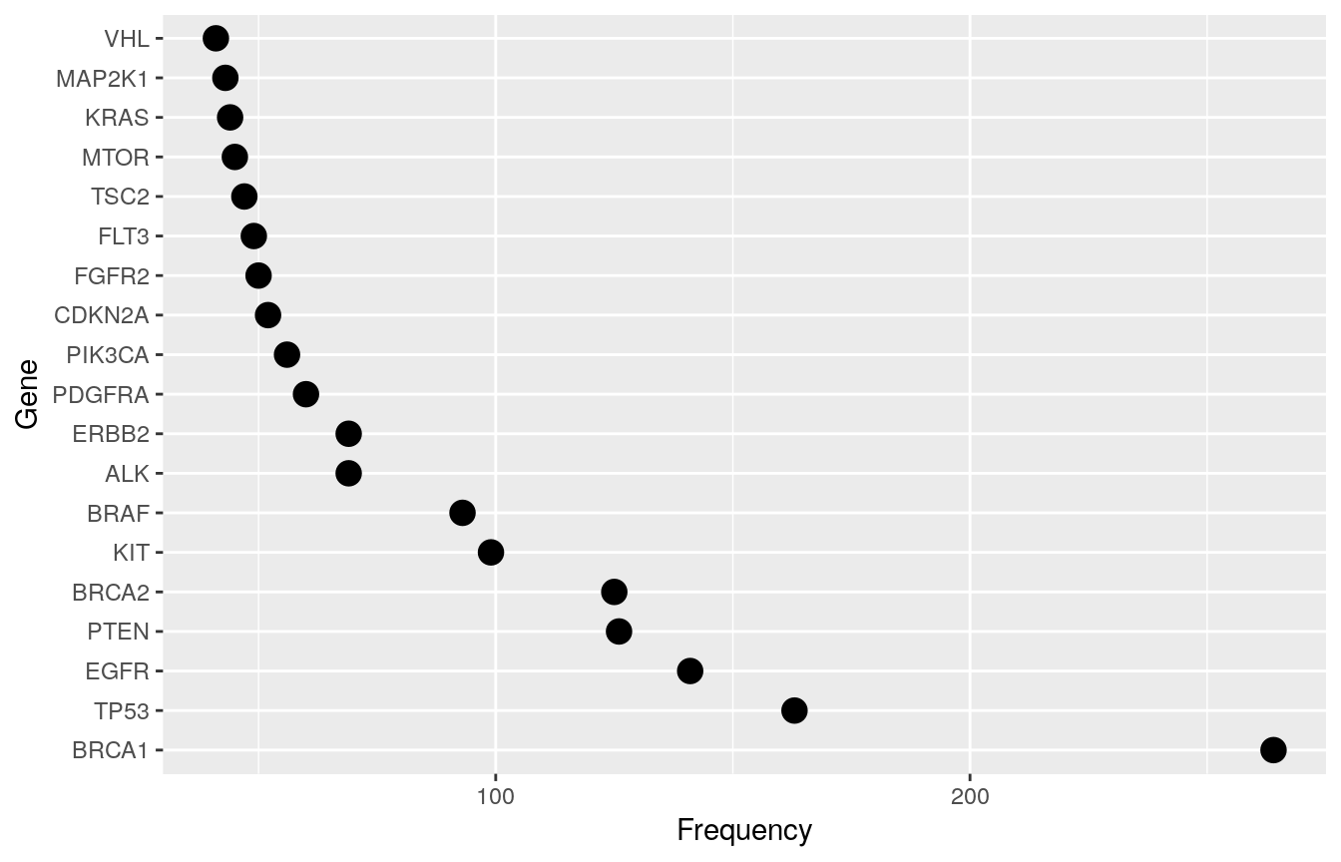
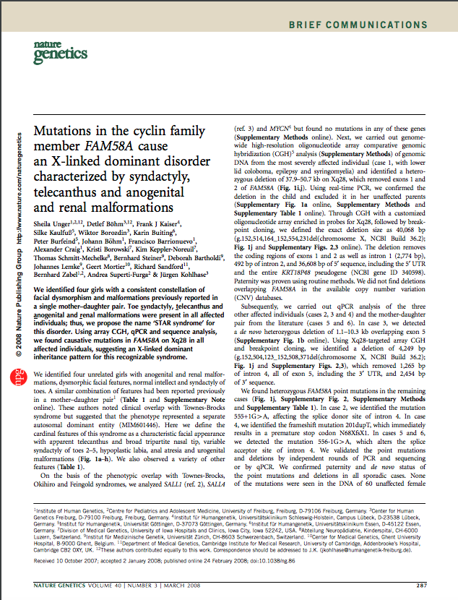
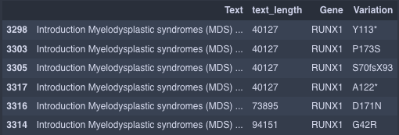
EDA
Missing Values
Inconsistent Data
Observations Disproportionately Represented
Shared Text Corpus for Multiple Variations
Same genetic code,
different result

Slide 5
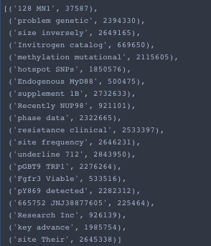
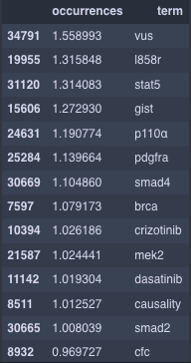
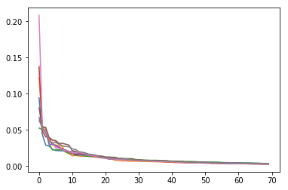
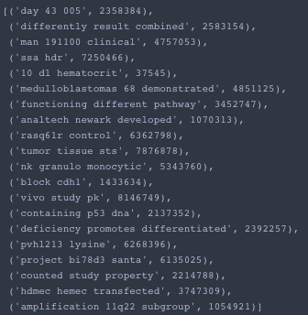
TF-IDF
Bigram- 2690998 tokens
Trigrams - 33,126,986 tokens
10% of Vocabulary
SVD
Explained Variance Vs. Number of Features
20 Features for dataset scaled to 10% of original
200 Final Model

Slide 6
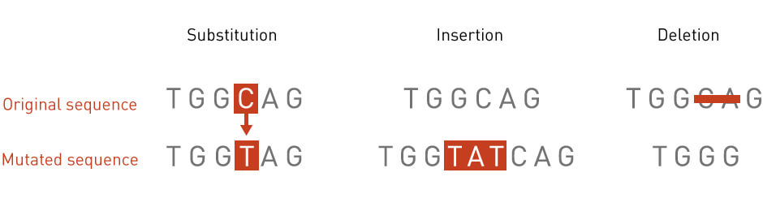
Types of Base Pair Substitutions
tmVar normalization format:
Substitution:
<Sequence type>|SUB|<wild type>|<mutation position>|<mutant>
e.g., "c.435C>G" --> "c|SUB|C|435|G"
Deletion:
<Sequence type>|DEL|<mutation position>|<mutant>
e.g., "c.104delT" --> "c|DEL|104|T"
e.g., "c.1544-?_2916+?" --> "c|DEL|1544-?_2916+?|"
Insertion:
<Sequence type>|INS|<mutation position>|<mutant>
e.g., "c.104insT" --> "c|INS|104|T"
Insertion+Deletion:
<Sequence type>|INDEL|<mutation position>|<mutant>
e.g., "c.2153_2155delinsTCCTGGTTTA" --> "c|INDEL|2153_2155|TCCTGGTTTA"
Duplication:
<Sequence type>|DUP|<mutation position>|<mutant>|<duplication times>
e.g., "c.1285-1301dup" --> "c|DUP|1285_1301||"
e.g., "c.1978(TATC)(1-2)" --> "c|DUP|1978|TATC|1-2"
Frame shift:
<Sequence type>|FS|<wild type>|<mutation position>|<mutant>|<frame shift position>
e.g., "p.Val35AlafsX25" --> "p|FS|V|35|A|25"
e.g., "p.Ser119fsX" --> "p|FS|S|119||"
<Sequence type>:
c: DNA sequence
r: RNA sequence
g: Genome sequence
p: Protein sequence
m: Mitochondrial sequence
<wild type> / <mutant>:
A,T,C,G: DNA nucleotide
C,I,S,Q,M,N,P,K,D,T,F,A,G,H,L,R,W,V,E,Y,X: Amino acid

Slide 7
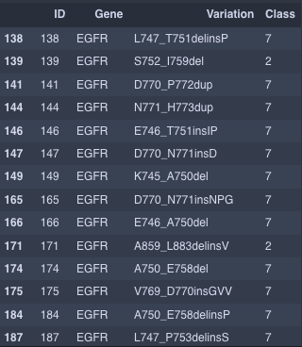
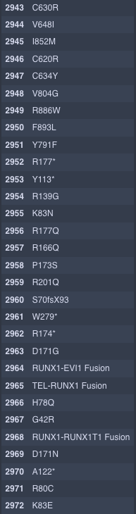
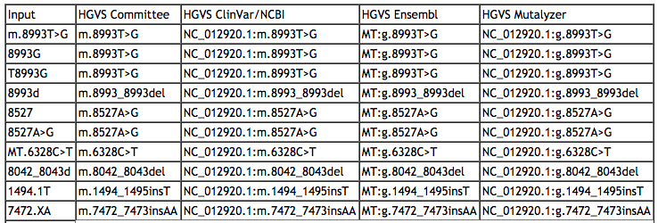
C630R
C 630 R
Cys 630 Arg
Cysteine 630 Arginine

Slide 8
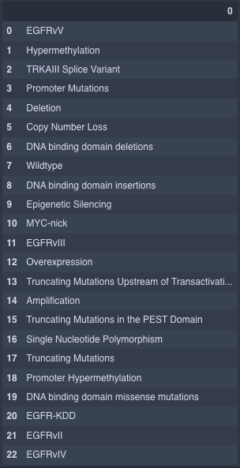
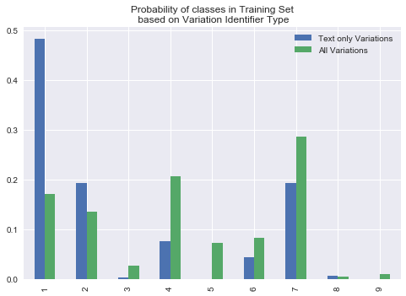
Variant Types

Slide 9
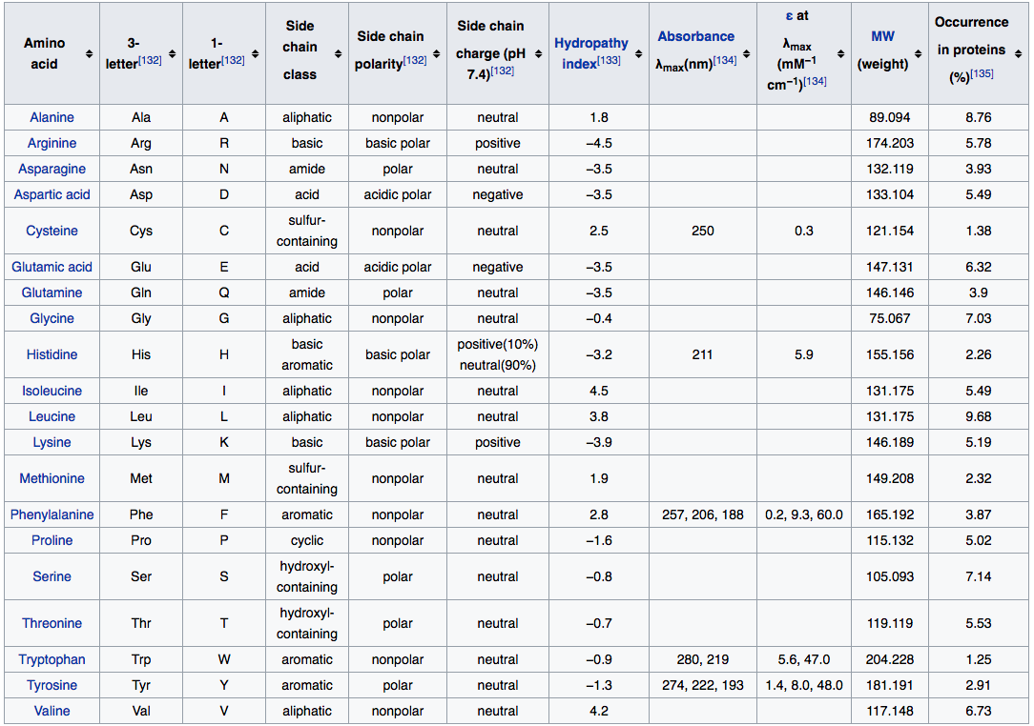
Variant Tyes

Slide 10
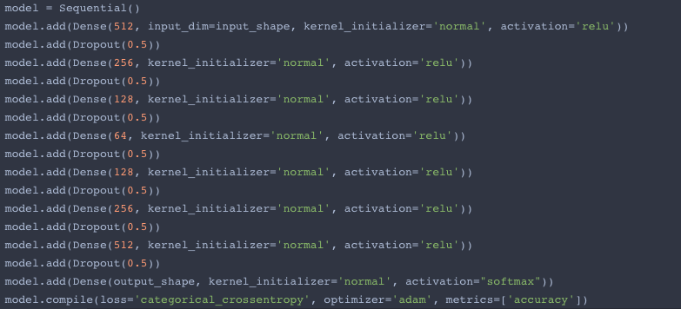
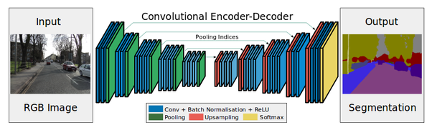
Model Architecture
Dense Network
(Similar Idea)

Slide 11
Lessons
Still to Try
Feature engineering takes a long time.
Genetics is complicated
Text mining is hard with limited data
Further exploration with models
Parsing external data sources:
Collect more text data using APIs
Collect more data on genes using APIs
Sampling methods to overcome data imbalance
Current best: 443 of 790
Score 0.82386

